Slide 1

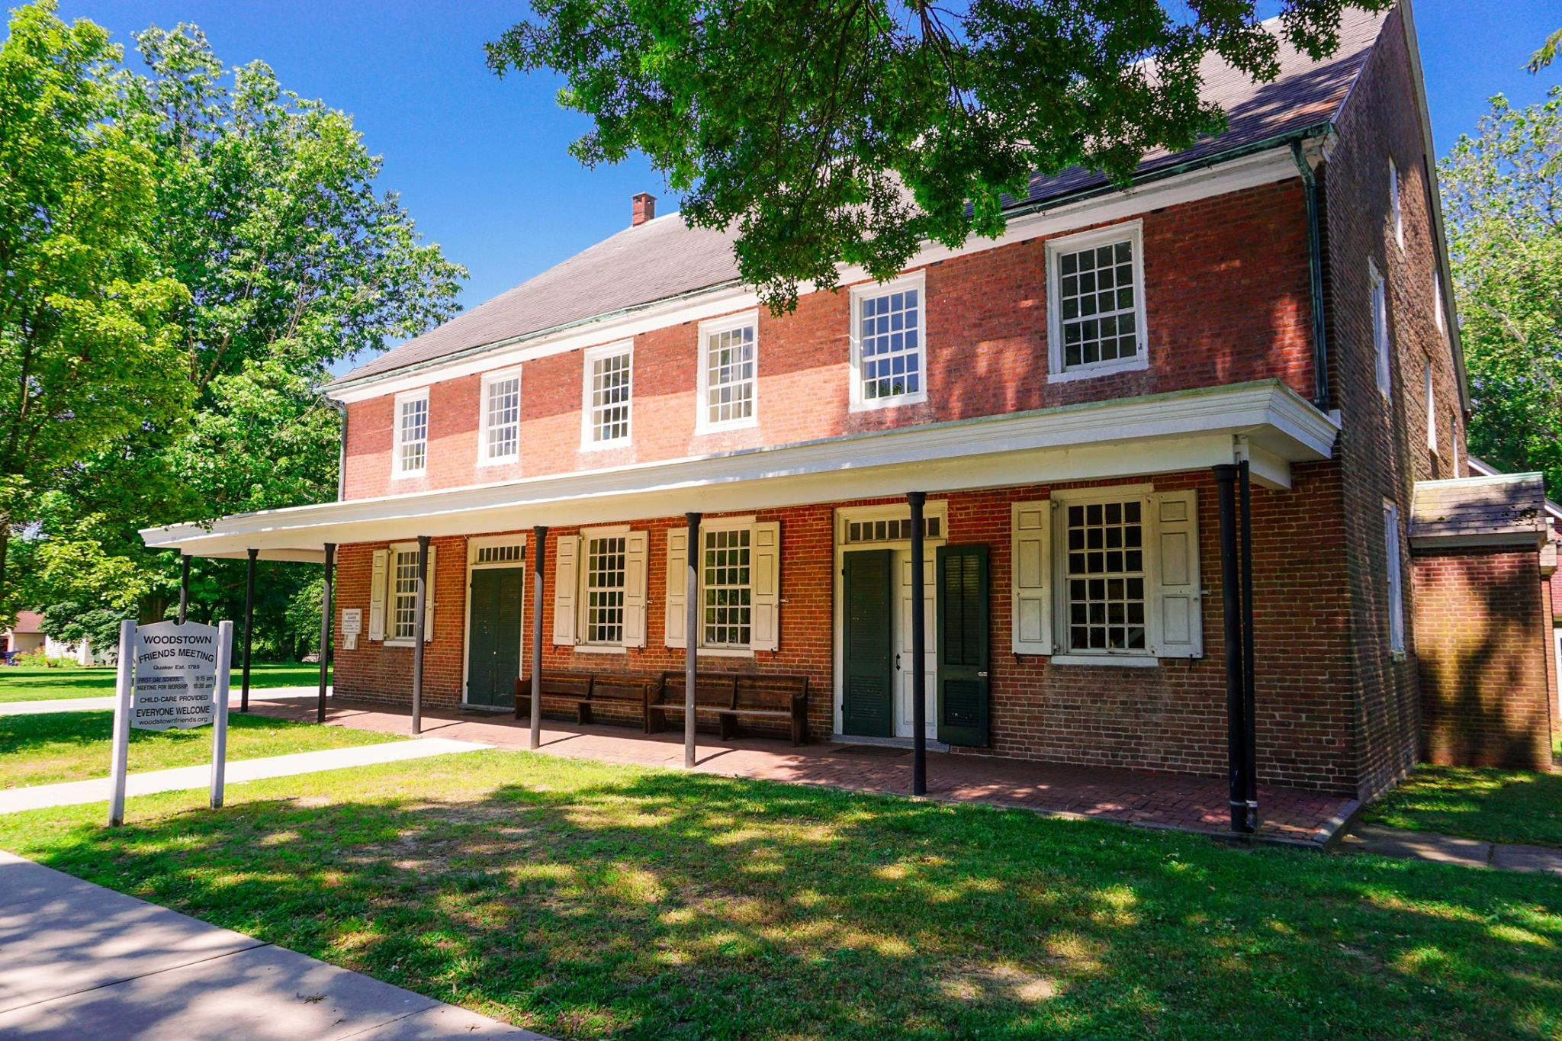
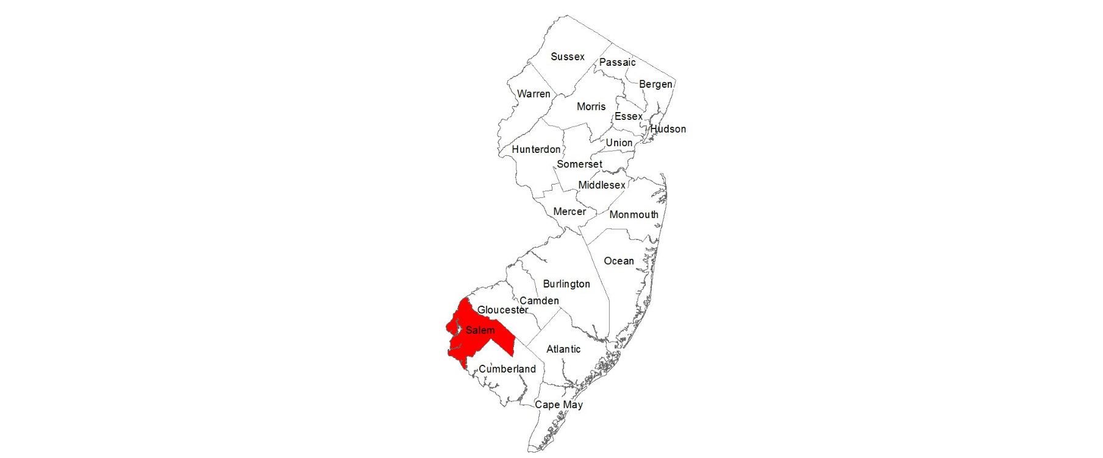
Samuel Silver- Third Generation
Time-line
Birth
1725 – Pilesgrove, Salem County, New Jersey
Parents: Archibald Silver II and Mary Cowgill
Marriage | Rebekah Pedrick
31 October 1765 – Pilesgrove Meeting House (AKA Woodstown), Salem County, New Jersey
Death
About 1789-Pilesgrove, Salem County, New Jersey
Woodstown Friends Meeting House 104 N Main St, Woodstown, New Jersey
Will
Meeting Minutes
Probated on 30 Sep1789-Pilesgrove, Salem County, New Jersey
The meeting spoke with Samuel’s children, after his death, and granted a request to take them under their care (William, Rebecca, Samuel and Archibald).
Samuel was a yeoman, meaning he owned and cultivating a small landed estate. He gave to his wife his Bible, cow and warming pan, and £10 yearly for 5 years. He divided the rest of his estate evenly between his children, when they came of age.
Children
Birth/Death
Ruth Silver
1765-1823
William Silver (Direct-line)
1773-1848
Rebecca Silver
1776-1840
Samuel Silver
1784-1829
Mary Silver
1790-1836
Archibald Silver
-1829

